Slide 1
Final presentation for team 3
Team member:
Lei Zhenghong
Peng Yuqi
Wang Weichen

Slide 2
Executive summary
Key insight | Description
Key clustering of the users in GoTrade | High value trading users | Stable trading users | Less active trading users | Dormant Users
 | Highest trading volumes Highest operation time | High trading frequency Low trading volumes Low operation time | Lowest trading frequency Lowest trading volumes | High trading volumes Highest churn percentage
 | Four group have different characteristics in trading value, trading times/frequency, session times and operation times, especially “Dormant Users” group has some interesting findings.
Key insight from the important features | By explorating the SHAP value plot, we found that buy/sell numbers, net flow and the history total events have positive impact on the future transaction values.
Marketing Strategies | The actual recommendations are based on the four groups and our findings: High value trading users: Build a community, recommend the products and others strategies Stable trading users: Offer session time rewards Less active trading users: Offer trading frequency rewards and others Dormant Users: Offer limited-time discounts and exclusive offers Notification system
Notes:
1:30
In the first part, we will be introducing the clustering result that we divided the users into four groups:
high value trading user, which has highest trading volume and highest operation time, that operation times we mean here is the number of events.
stable trading users, which has high trading frequency, low trading volumes and low operation times, where the trading frequency we take products and days into consideration
less active trading users, which has lowest trading frequency and lowest trading volumes
dormant user, which has high trading volume but they have the highest churn percentage, the dormant we mean here is that this group of users has left the app but may come back in the future. Meanwhile, we did some research toward the dormant users group and find that there are some interesting finding during the week before they churned.
Next, based on the regression model that we predicted their future transaction, we explorating the SHAP value plot and found that buy/sell numbers, net flow and the history total events have positive impact on the future transaction values.
So, finally we had our recommendation toward the marketing strategies that are given based on the characteristics of four group by keeping beneficial character and improving negative character. Besides, we also recommend the strategies of increasing the transaction values by following the characteristics that are highly related to that.
The actual recommendations are based on offering rewards and discounts, recommend the product, build community, notification system and other strategies.

Slide 3
Leveraging features across Users profile, usage behavior, trades activities, deposit and withdrawals
Trades
Usage Behaviour
Number of buy/sell transactions
Amount of buy/sell transactions
Trading frequency
Net Flow
Market situation
Session length
Total events
Screen (Stock) event Count
Tap (Stock) event Count
Tap (Withdraw) event Count
User data
Deposit and Withdrawal
User profile
Number of withdrawals
Amount of withdrawals
Amount of deposit
Number of deposits
Churn percentage
Source of wealth
Employment status
Notes:
Based on our research on the financial users and in-depth study of the user data, we divided the user data into 4 parts, such as trade related behavior Usage Behavior. From these data we selected or generated some important features for subsequent analysis like Trading frequency, Number of withdrawals. We use these features do further segment and prediction

Slide 4
Four groups were identified across the profit and loyalty spectrum
Group 1:
High value trading users
（718 (26.6%)）
Group 2:
Stable trading users
787 (29.1%)
Highest trading volumes
Highest operation time
Loyalty
High trading frequency
Low trading volumes
Low operation time
Group 3:
Less active trading users
336 (12.4%)
Group 4:
Dormant Users
466 (17.3%)
Lowest trading frequency
Lowest trading volumes
High trading volumes
Highest churn percentage
Profit
Notes:
This diagram shows our clustering results. The numbers under each group show the number of people in each group and their proportion. Group 1 are the high-value users who use the software with longest time and have high trading frequency and trading volume. Group2 is a stable trading user with a high trading frequency, but the trading volumn is relatively small so their investment strategy is more cautious. Group 3 represents inactive users with very low trading frequency and volumn.. Group4, is The Dormant Users who have relatively high trading volumn, but their Churn_pertage is very high, indicating that they have no money in their accounts anymore . These are the people who used to be active but are no longer using the our software. So we called them dormant traders.

Slide 5
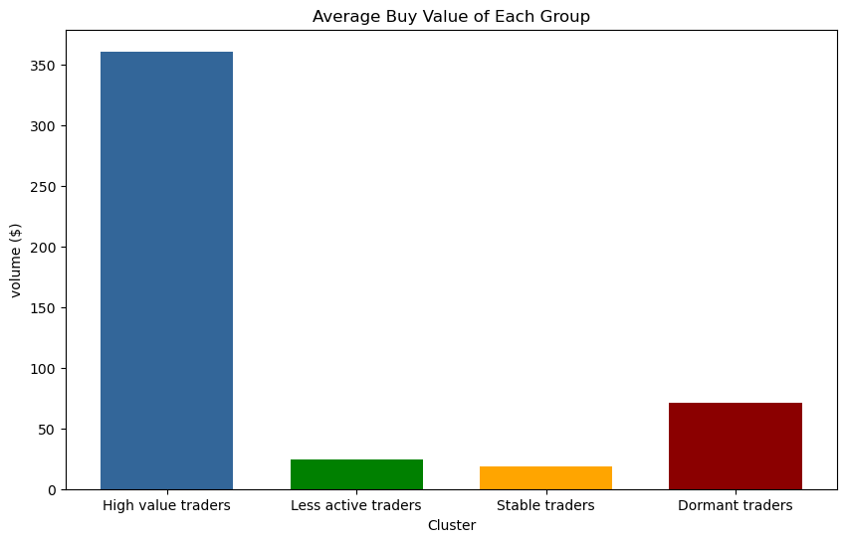

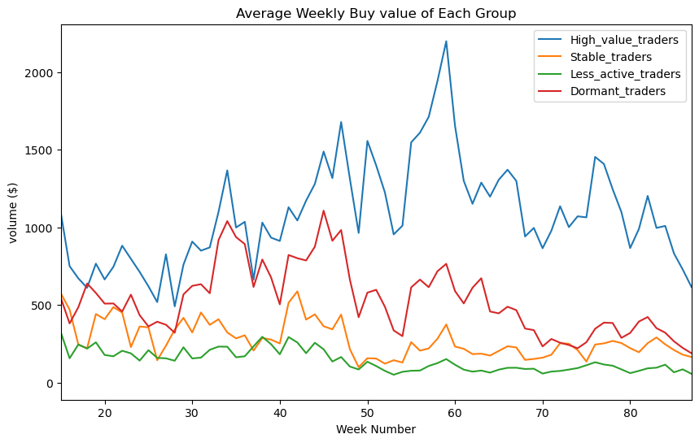
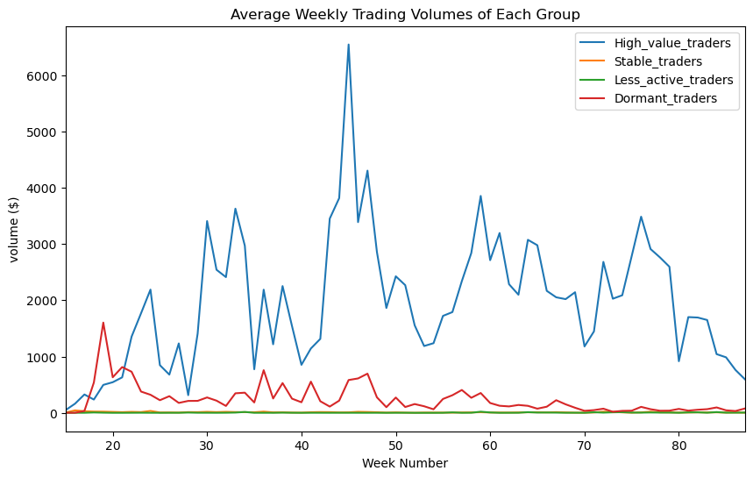
High value trading group has the highest buy and trading value
High value trading users
Highest trading volumes
Highest operation time
Less active trading users
Lowest trading volumes
Lowest trading frequency
Stable trading users
Low trading volumes
High trading frequency
Low operation time
Dormant Users
Highest churn percentage
Less activity after they churn
Findings:
High value trading group have the highest buying value and trading value (buy + sell), while dormant traders group seems to have high trading value before they have churned.
So, we should focus on keeping the high trading volume for high value group, as well as improving trading volume of stable trading users and less activate trading users.
Notes:
We then make some exploration analysis base on the four group of users
The bar charts above shows the average buy value and trading value of these four groups.
While the line plots below shows the change of these data over weeks.
From these graphs, we can see that High value traders always have the highest buying value and trading value while Stable traders and Less active traders both have a lower value.
For dormant traders, we can see that they use to make certain amount of trades, but their average trading value gradually decreased as time went buy. We can see this trend through the dotted line marked in the picture, which suggest that this group of users are going dormant.
As a result, we should focus on keeping the high trading volume for high value group, as well as improving trading volume of stable trading users and less activate trading users.

Slide 6
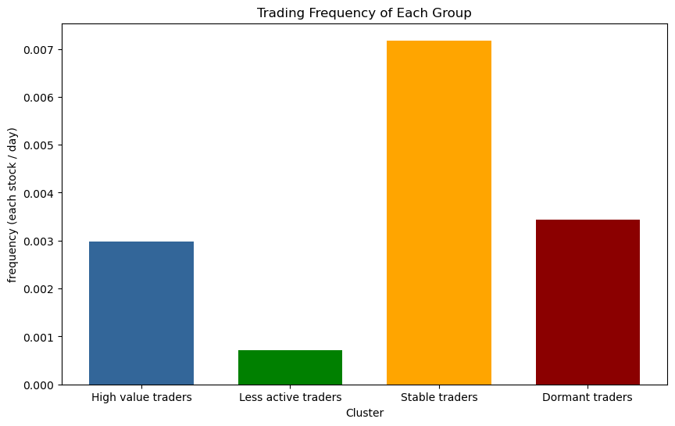
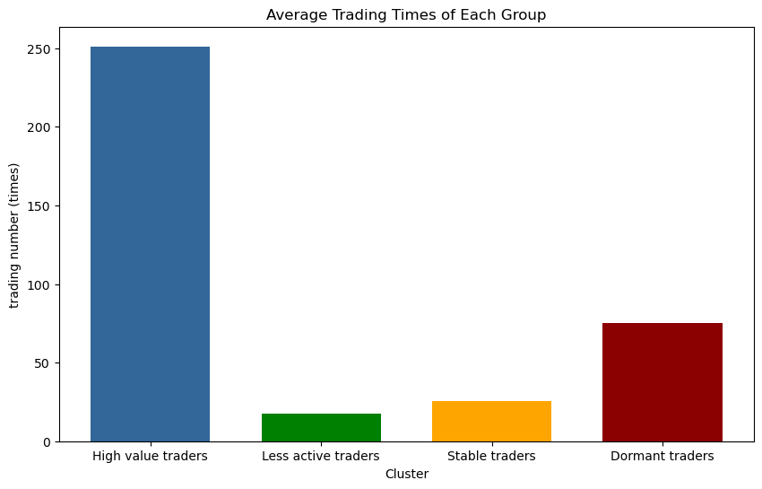
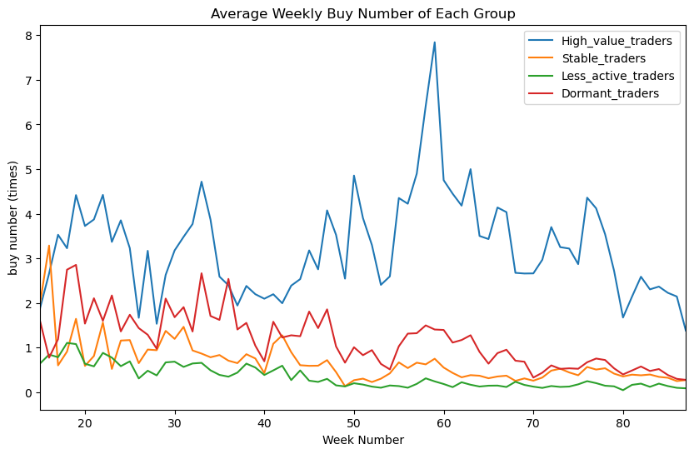
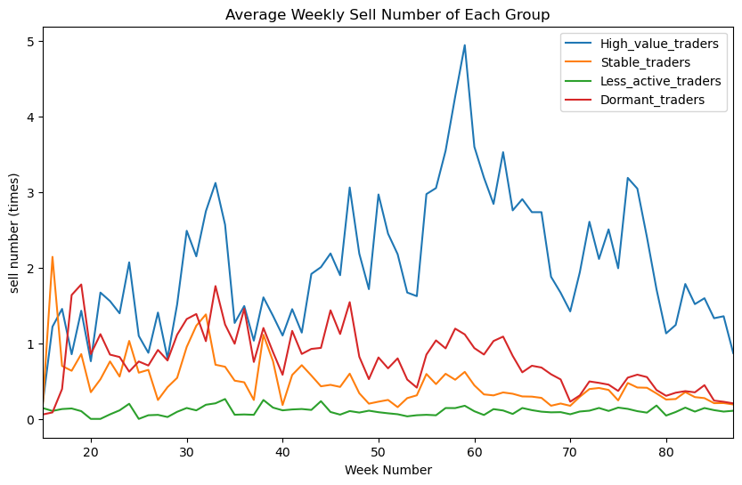
Stable traders group has the highest trading frequency on each stock, while high value trading group has the highest number of trading
High value trading users
Highest trading volumes
Highest operation time
Less active trading users
Lowest trading volumes
Lowest trading frequency
Stable trading users
Low trading volumes
High trading frequency
Low operation time
Dormant Users
Highest churn percentage
Less activity after they churn
Findings:
Stable traders is likely to trade frequently on single stock.
So, we should focus on keeping the high trading frequency for stable trading group, as well as improving less activate trading user’s trading frequency.
Notes:
In terms of transaction frequency, Stable traders group has the highest trading frequency on each stock, while high value trading group has the highest number of trading
The bar chart on the left shows how many days it take a user to trade a stock for a certain company, while the bar chart on the left shows the average trading times of each group.
From these two plots, we can see that although high value traders have the highest trading times, stable traders stand out in the trading frequency.
This suggest that high value traders tend to own multiple stocks and trade them with moderate frequency, while stable traders tend to own less stock but trade them with a higher frequency.
Although stable traders and less active traders both have the lowest trading value, stable traders are more loyal to our software due to their high trading frequency on each stock.
Therefore, we can focus on keeping the high trading frequency for stable trading group, as well as encourage less activate trading user to trade more frequency.

Slide 7
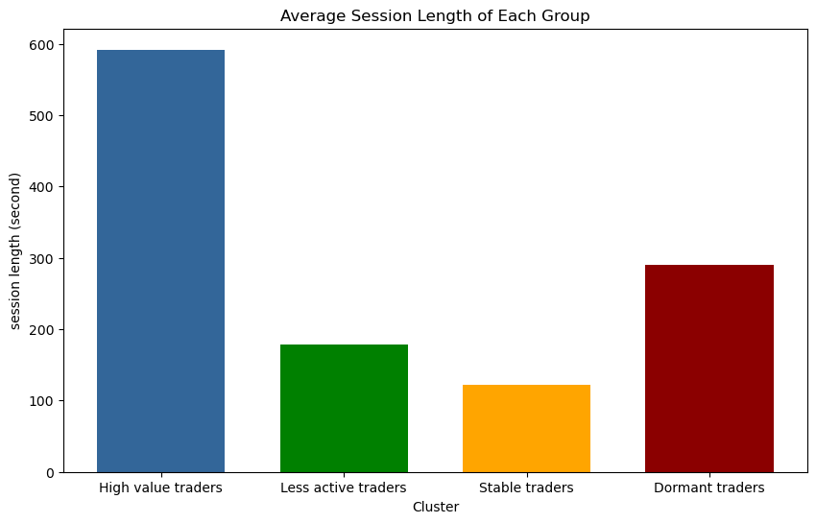
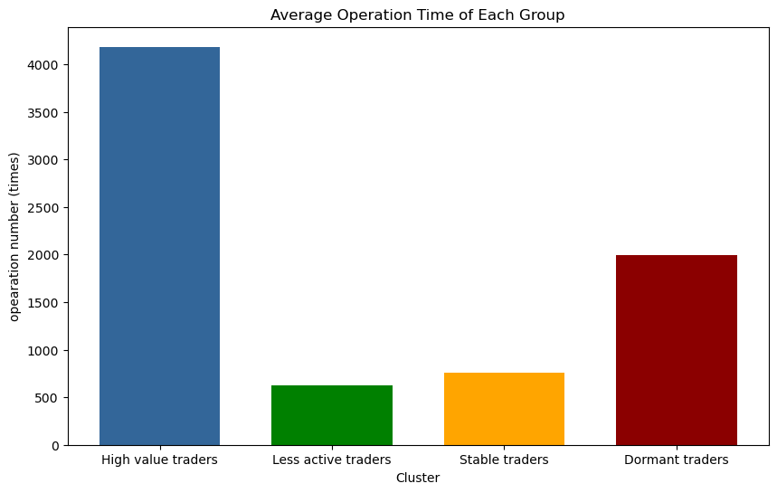
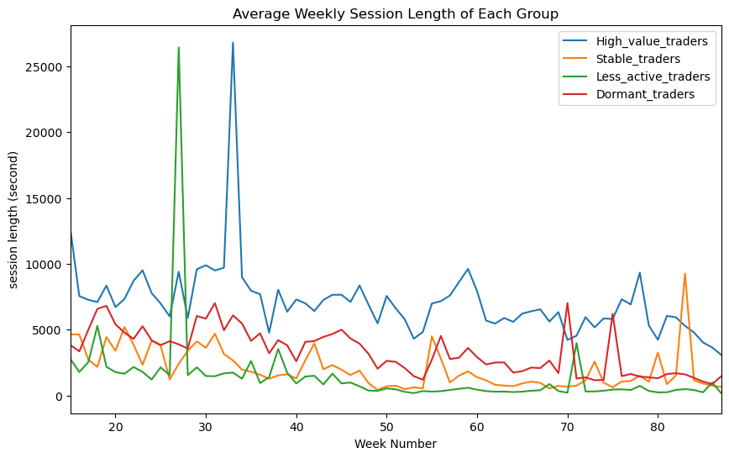
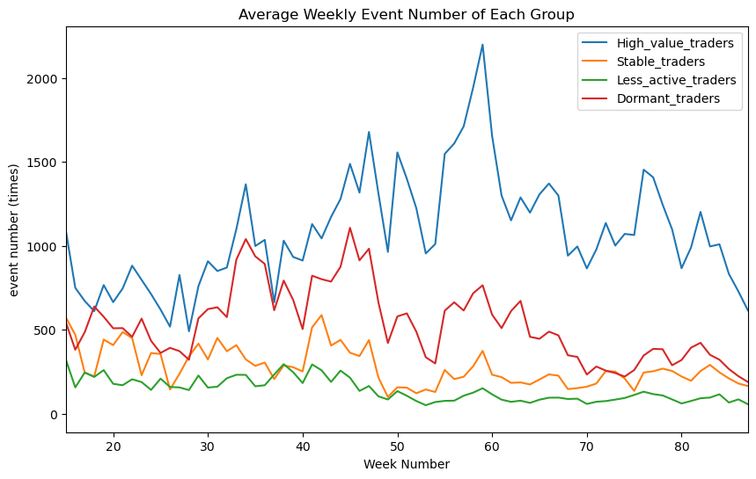
High value trading group has the highest session length and operation times
High value trading users
Highest trading volumes
Highest operation time
Less active trading users
Lowest trading volumes
Lowest trading frequency
Stable trading users
Low trading volumes
High trading frequency
Low operation time
Dormant Users
Findings:
High value trading group has the highest session length and operation times, while less active trading group and stable trading group have less activeness.
Dormant traders group seems to be active before they have churned.
So, we should focus on keeping the high operation time for high value trading group, as well as increasing less activate trading user’s operation time.
Highest churn percentage
Less activity after they churn
Notes:
This four graphs shows the session length and operation number of different groups.
We can see that our high value traders have the highest session length and operation numbers
while less active trading group and stable trading group have less activeness
So, we should focus on keeping the high operation time for high value trading group, as well as increasing less activate trading user’s operation time.

Slide 8
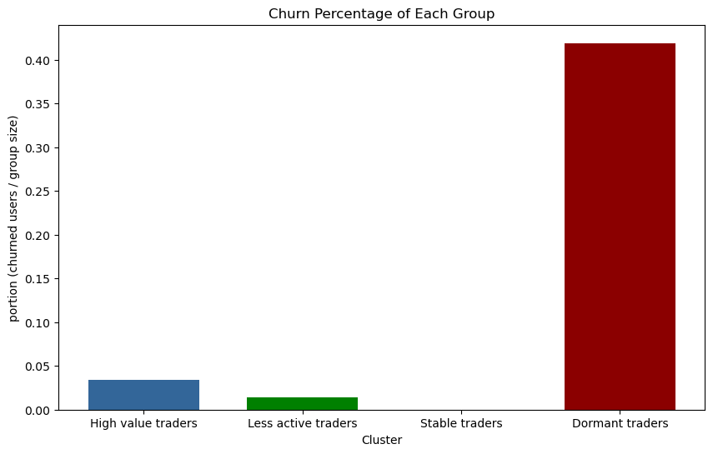
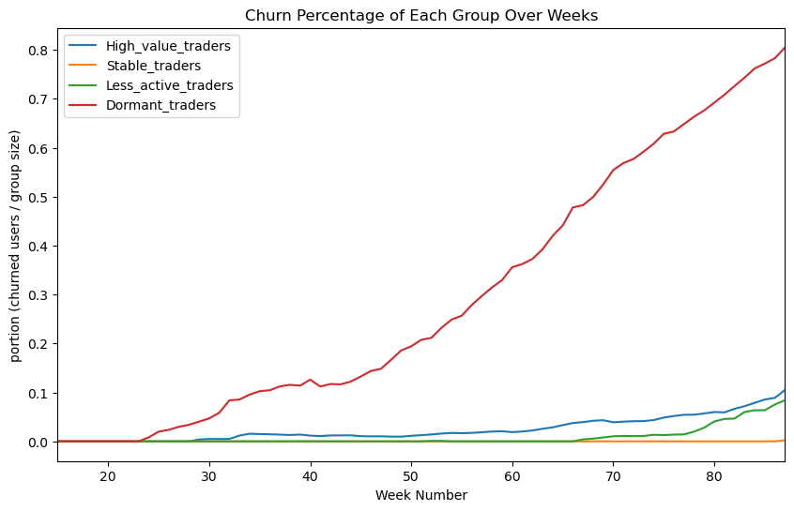
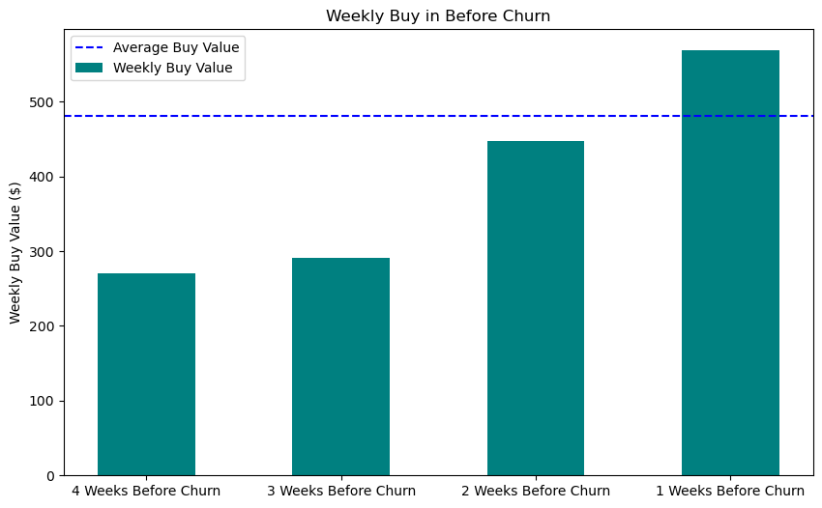
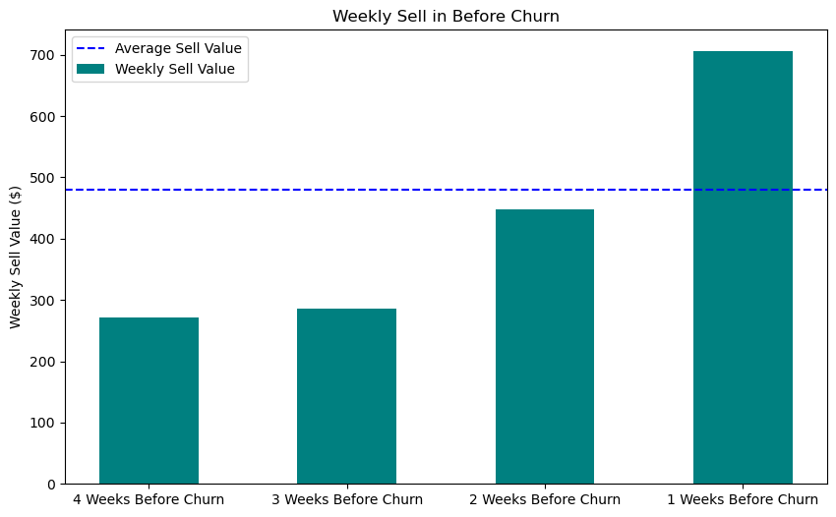
The increasing in buying volume and sell volume of the latest week before they churned are higher than the average level of their past transaction
Dormant Users
Highest churn percentage
Less activity after they churn
Characteristics before they churn:
Increase in sell and buy volume
Increased willingness to withdraw efficient operations
Observation:
The user’s buying volume and sell volume of the current 2 weeks before they have churned have a great increase.
The increasing in buying volume and sell volume of the latest week before they churned are higher than the average level of their past transaction.
Notes:
Dormant user group have a high churn percentage, which means they have withdraw all their money from their account at a certain point.
In order to further explore their activities before they churn, we analyze the first four weeks of churn for this group of users.
Here are our findings
firstly, there is a increase in sell and buy volume before they churn.
Through the plot we can see , the user’s buying volume and sell volume of the current 2 weeks before they have churned have a great increase.
In the last week, their buying volume and sell volume even exceed the average level of their past transaction.

Slide 9
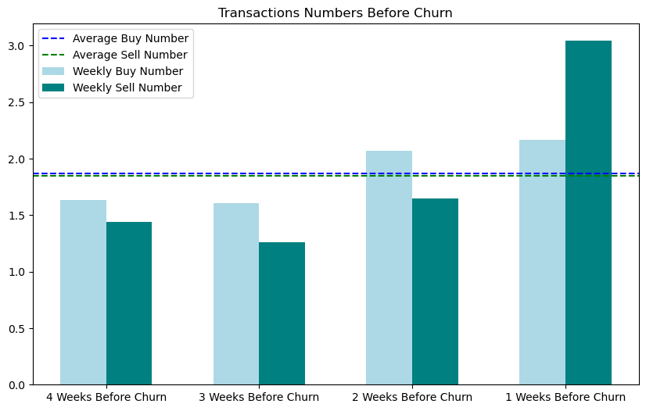
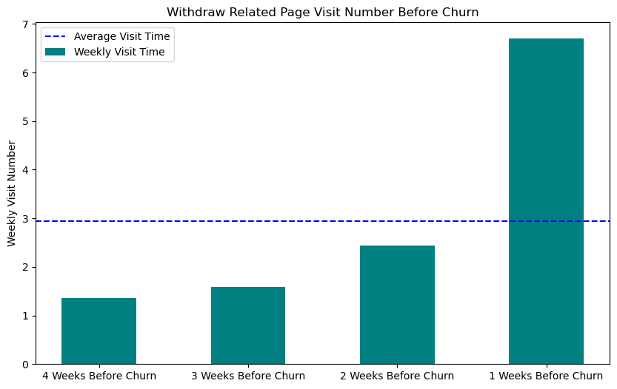
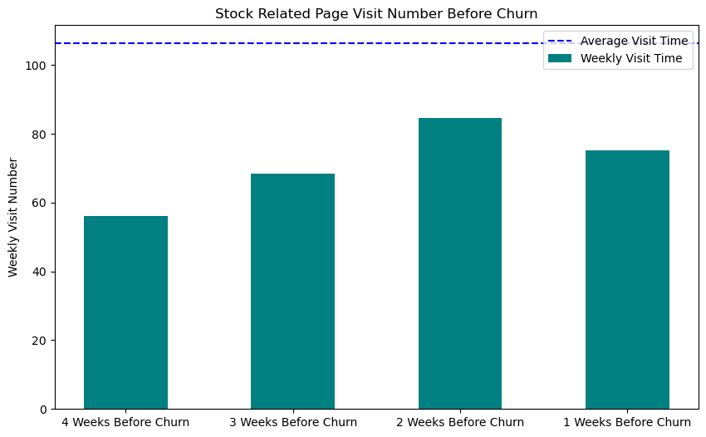
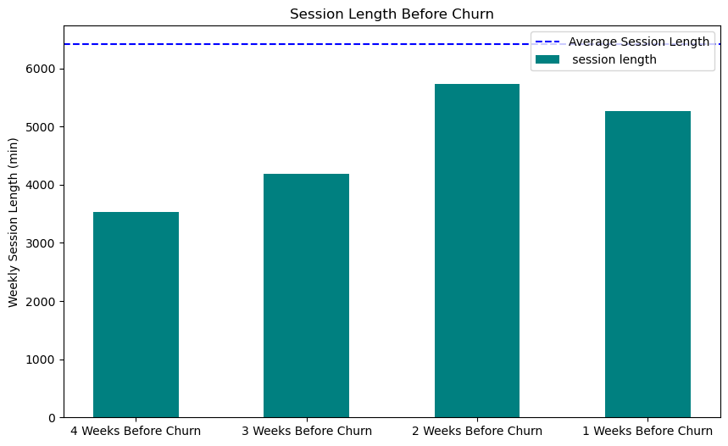
The number of visiting withdraw related pages greatly increase before the dormant users churned
Dormant Users
Highest churn percentage
Less activity after they churn
Characteristics before they churn:
Increase in sell and buy volume
Increased willingness to withdraw efficient operations
Observation:
Selling number exceed buying number in the last week. Meanwhile, the number of visiting withdraw related pages greatly increase.
Before these users churned, although there is an increasing trend both in trading volume and trading frequency, their operations in the software do not increase.
Notes:
Secondly, we can see an increased willingness to access withdraw efficient operations
In the first three week, weekly buy number is higher than weekly sell number, however, in the last week, sell number exceed buy number.
In the same week, the number of visiting withdraw related pages greatly increase.
On the contrary, although there is an increasing trend both in trading volume and trading frequency, their operations in the software do not increase
such as stock related page visiting time and the session length, which still stay below the average line of these group.
All those features point out that the increase in their trading is not for increase their investment in the stock market, but for converting their money from stocks into account balance, then they can withdraw their money.

Slide 10
Evaluating the model of the prediction for future transaction
 | MAE | RMSE
High value trading users
Decision Tree Regressor | 4827.1 | 44680.1
Gradient Boosting Regressor | 3355.3 | 24289.7
Stable trading users
Decision Tree Regressor | 25.44 | 293.5
Gradient Boosting Regressor | 21.21 | 245.2
Less active trading users
Decision Tree Regressor | 18.55 | 166.1
Gradient Boosting Regressor | 14.87 | 116.9
Dormant Users
Decision Tree Regressor | 488.6 | 5515.4
Gradient Boosting Regressor | 344.9 | 4005.3
Target variable:
The target variable is setted to be the next week‘s transaction values of each users.
Regression Model:
Gradient Boosting Regressor:
Be able to capture nonlinear relationships in the data.
Be able to process data sets containing numerical and categorical features.
Be able to capture the complex interactions between features.
Cross validation: 10 fold
Grid Search (GridSearchCV)
Notes:
After the clustering analysis, we want to conduct a more in-depth analysis of each cluster, and we want to obtain which features are the key to driving the transaction volume of these clusters. We choose to use Gradient Boost as our model to predict users' trading volume next week. It can be seen that compared to Decision Tree, Gradient Boost has a better effect and can better capture the complex relationships in the data. For the High value group, their errors are large, which does not mean that the model is ineffective to them. It is because their trading volume within a week is very large, resulting in large fluctuations in predictions.

Slide 11
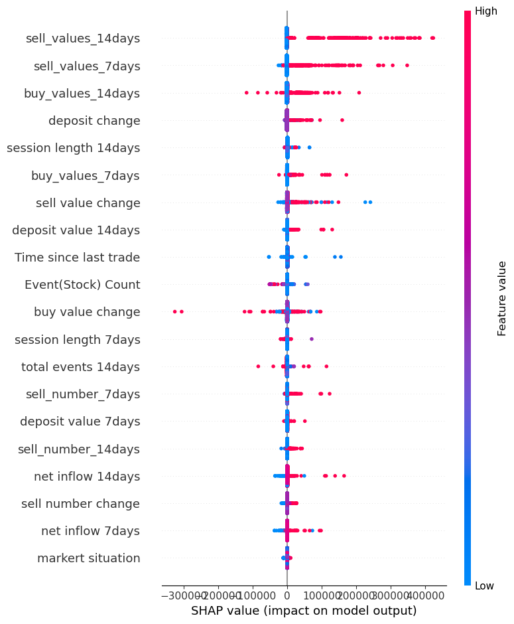
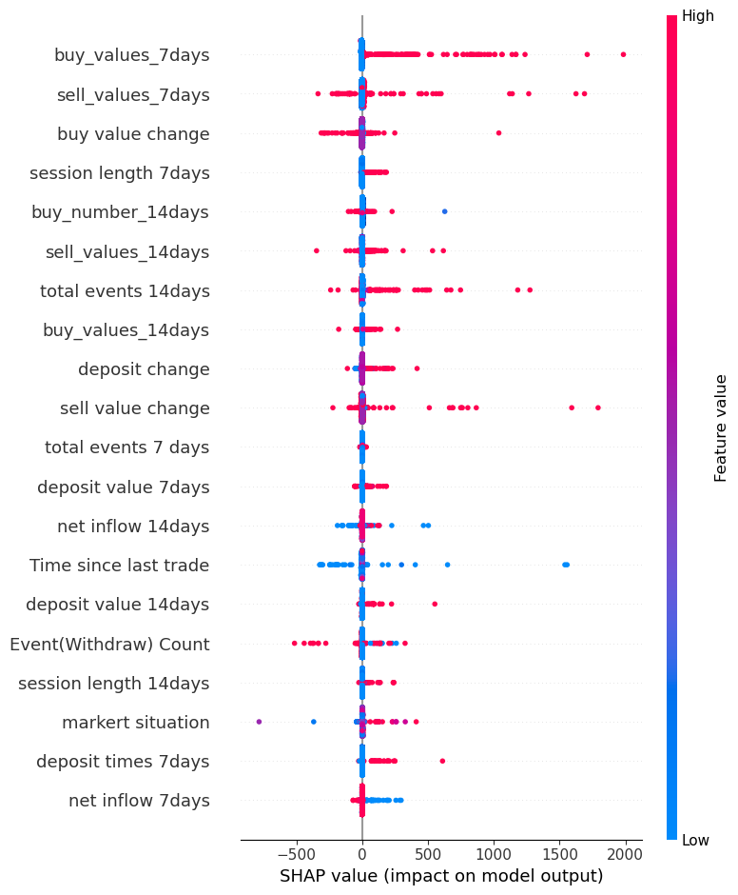
SHAP Value Analysis
High value trading users
Dormant Users
Observations:
Blue part and red part refers to the low feature value and high feature value.
Focus on the feature that has clear separation between blue part and the red part.
If we look at buy_values_7_days, it is mostly high with a positive SHAP value. This means that higher buy values within 7 days would tend to positively affect the output
Notes:
This is the sharp value analysis of the two clusters that we think are the most important.。
Blue part and red part refers to the low feature value and high feature value. If we look at buy_values_7_days, it is mostly high with a positive SHAP value. This means that higher buy values within 7 days would tend to positively affect the output.
In fact, it can be seen that the most influential features of these clusters are those related to trading behavior. The same is true for the other two groups.
But there are also some interesting characteristics. For example, for high value traders, their deposit behavior is highly correlated with the trading volume of the next week.

Slide 12
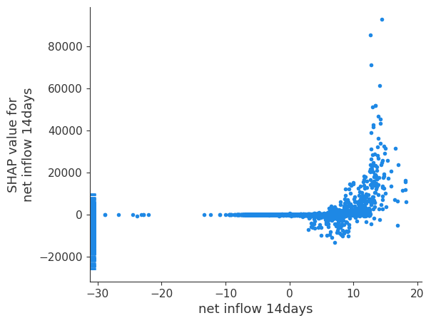
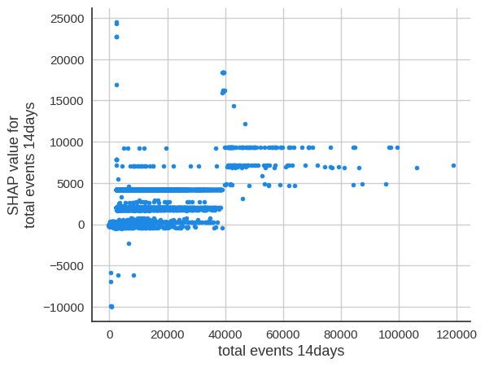
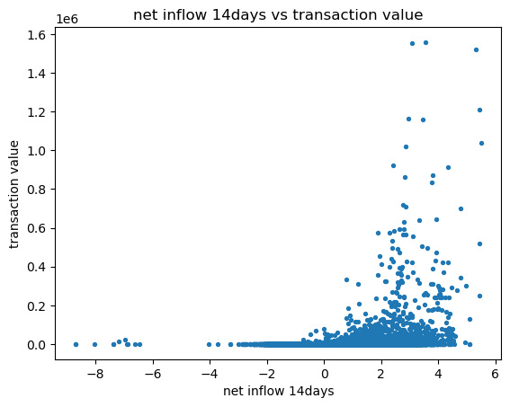
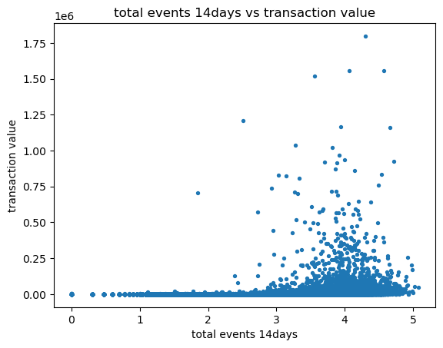
The causal drivers responsible for the value of transactions a user will make in the future
Observation:
When net flow < 0, the SHAP value is around 0, indicating total transaction in the next 7 days may decrease. While when net flow > 0, user’s total transaction in the future may increased.
From the scatter plot we can see that users tends do more transaction in the future as they earned money in the past.
When the total events > 40000, it has high impact on transaction value in the next 7 days. While lower total events may have less impact.
From the scatter plot we can see that users tends do more transaction in the future as they spent more events in the past, especially after 40000 total events.
Notes:
We also do sharp value analysis on all the users.
From the left two figures we can see
When net flow < 0, the SHAP value is less than 0,This means that when the outflow of funds from a user's account exceeds the inflow, the model believes that the user may have less trading activity in the future;
While when net flow > 0 That means inflows exceed outflows, the model believes your trading activity is likely to increase in the future.,
If we plot the net flow and transaction value in one figure. Seeing in the left scatter plot . we can also see that users tends do more transaction in the future as they earned money in the past.
When the total events > 40000, it has high impact on transaction value in the next 7 days. While lower total events may have less impact.
And we can also validate it in the scatter plot

Slide 13
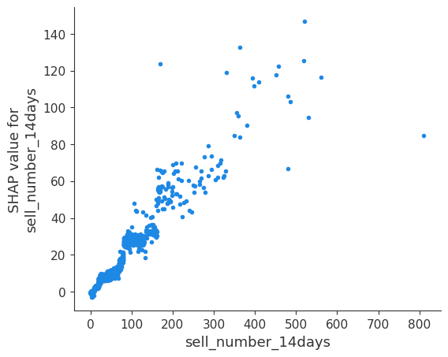
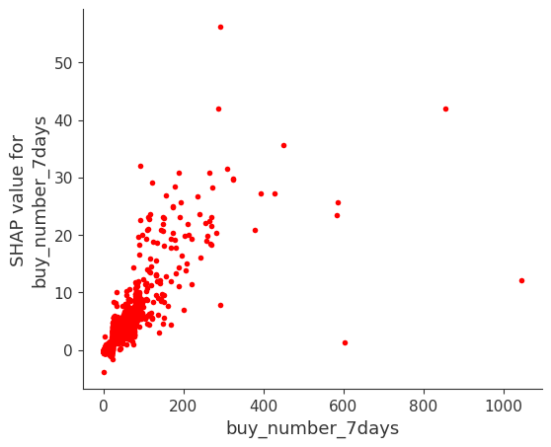
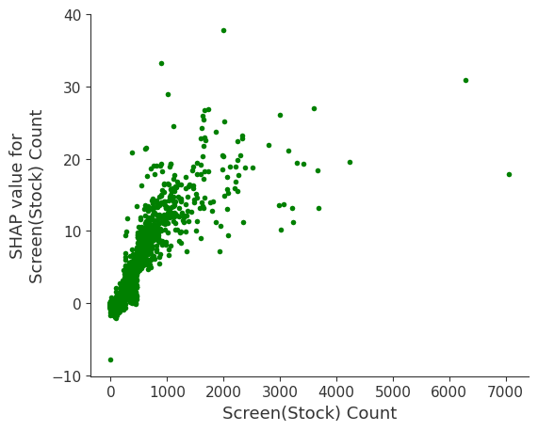
The causal drivers responsible for the number of buying a user will make in the future
Observation:
Higher number of sell in the past 14 days may increase the number of buy that the user will make in the next week. his indicates that the number of buys and sells by the user are mutually driving each other.
The increasing of the number of buy in the past 7 days may increase the number of buy of the user in next week. Indicating that user buying behavior exhibits a certain level of continuity.
The more stock-related screens a user visits, the more likely they are going to buy in the next week.
Notes:
From first figure we can see The number of selling user will make next week is linearly related to the number of user selling in the previous 14 days, indicating that user purchasing behavior exhibits a certain level of continuity and predictability in the short term.
The increasing of the number of buy in the past 7 days may increase the number of sell of the user in next week. This indicates that the number of buys and sells by the user are mutually driving each other.
And from the third figure we can see that The more stock-related screens a user visits, the more likely they are going to sell or buy in the next week.

Slide 14
Marketing strategies for high value trading users
Findings
Strategies
What we believe
Offer trading value rewards (Low cost)
Set the monthly goals of trading values. Once they have achieved the goals, we can offer them products with less fees or cash back.
High trading volume correlated with high profit
Encourage them to achieve the goals, instead of relying entirely on their own willing to trade and keep high trading.
High operation time correlated with high loyalty
The total events have a positive impact on the transaction value in the future
Build a community (Medium cost)
The community allows users to post their opinion and investment experience in the community, while other users can also view what they have posted and make comment on it.
The community will update market news and recommend news for different segment of users based on their profile.
The professional ideas and experiences from high value trading users will interact other users to spend more time on the app and become more confident in trading.
Meanwhile, these posts can attract new users to join the GoTrade.
The recommended news will interact the users to increase the event on the app.
High number of average trading times correlated with high profit and loyalty
Recommend the products in the user’s best preference sector (Medium cost)
Based on the sectors of the product that each users has brought, we can recommend the product that are in the same sector.
Since average trading times is high, the accuracy for recommendation will be outstanding, so we apply more calculation.
Providing personal recommendation can help remaining their high trading frequency.
Notes:
1:40
Finally, we had our marketing strategies, so first are the strategies toward the high value trading users
Since, this group has high trading volume that correlated with high profit, we can offer them trading value rewards, that set the monthly goals of trading values. Once they have achieved the goals, we can offer them products with less fees or cash back. So that we can encourage them to achieve the goals, instead of relying entirely on their own willing to trade and keep high trading.
Meanwhile, the user in high value trading group has high operation time that correlated with high loyalty, and based on our finding that The total events have a positive impact on the transaction value in the future. we can build a community that allows users to post their opinion and investment experience in the community, while other users can also view what they have posted and make comment on it. and The community will updating market news and recommend news for different segment of users based on their profile.
In this way we believe that The professional ideas and experiences from high value trading users may interact other users to spend more time on the app and become more confident in trading. and Meanwhile, these posts can attract new users to join the GoTrade, while The recommended news will interact the users to increase the event on the app.
Besides, the user in this groups also has High number of average trading times correlated with high profit and loyalty, that we can recommend the products in the user’s best preference sector based on the sectors of the product that each users has brought. and since the average trading times is high, the accuracy for recommendation we believe may be outstanding and help them remaining high trading frequency.
# The rewards are based on the monthly profit of the company, as the company can take 2%-5% of the profit for the rewards

Slide 15
Marketing strategies for stable trading users
Findings
Strategies
What we believe
Offer session time rewards (Low cost)
Set the goal of session time they spend on Gotrade weekly/monthly. Once they reached the rewarding session time, we can offer them products with less fees.
Low operation time correlated with low loyalty
Therefore we want to increase operating time
Encouraging the users to use GoTrade more frequently. Thereby increasing users engagement and making them more inclined to use GoTrade in the long term.
Recommend the products in the user’s multiple preference sectors (Medium cost)
Based on the sectors of the product that each users has brought, we can recommend the products that are in the similar sector.
Since the number of average trading times is low, the accuracy for recommendation may not be outstanding, so we apply less calculation. Therefore we recommend products in multiple sectors instead of specific sector.
Providing personal recommendation can help remaining their high trading frequency.
High trading frequency correlated with high loyalty
Notes:
1:00
Next, for the stable trading users, we got two strategies
first is offering them session time rewards, since the users in this group have low operation time that correlated with low loyalty that we want them to be increased, so that we can set the goal of session time they spend on Gotrade weekly/monthly. Once they reached the rewarding session time, we can offer them products with less fees. In this way we believe we can encourage the users to use GoTrade more frequently. Thereby increasing users engagement and making them more inclined to use GoTrade in the long term.
Besides, we can also recommend the products to the users as they have high trading frequency as well. However, the users in this group do not have that high trading times, so we will recommend the products in multiple preference sectors instead of in the best one like in the high value trading users.

Slide 16
Marketing strategies for less active trading users
Findings
Strategies
What we believe
Low trading frequency correlated with low loyalty and profit
Therefore we want to increase trading frequency
Offer trading frequency rewards (Low cost)
Set the goal of the number of trading with a time limited. Once they reached the goal of the number, we can offer them products with less fees and cash back.
Encouraging the users to trade more frequently, instead of relying entirely on their own willing to trade, as the rewards can drive them to do more trading to achieve the goal.
Low trading volume correlated with low profit
Therefore we want to increase trading volume.
Provide financial and investment educational resources (Medium cost)
The app can provide some financial and investment lectures and invite experts to answer the questions.
Since their number of trading is small and the trading frequency is low, providing them educational resources can improve their investment skills.
Therefore they will become more confident in trading.
Notes:
0:50
And we also have two marketing strategies for less active trading users.
so we can offering them trading frequency rewards, that the users in this group have low trading frequency correlated with low loyalty and profit and we want to increase trading frequency by Setting the goal of the number of trading with a time limited. Once they reached the goal of the number, we can offer them products with less fees and cash back. and in this way we believe we can Encourage the users to trade more frequently, as the rewards can drive them to do more trading to achieve the goal.
Meanwhile, by providing financial and investment educational resources, we can improve their investment skills. Therefore they will become more confident in trading and the trading volume for the users in this group may be increased.

Slide 17
Marketing strategies for dormant users
Findings
Strategies
What we believe
More than 80% users in this group have churned
The increasing churn percentage represent a decline in the loyalty of this group of users
Offer limited-time discounts and exclusive offers (Low cost)
Once they return to GoTrade, we can first offer them products with less fees.
After they have successfully make a few transactions, we can further offer them some exclusive offers such as cash back. These offers will stop after they have been trading for a few weeks.
The main purpose is to encourage them get back and trade on GoTrade again.
To prevent losing money cause by fake operations. We can first attract them by discount in fees. Then, to keep their interest in our app, we can offer them small amount of cash back weekly once they successfully make transactions.
This group used to bring profits to GoTrade
Send personalized emails or messages (Low cost)
After they have churned, we can send personalized emails to inform them the recent trend the product they once brought, or recommend some promising stocks.
We want to use personalized messages to stimulate users’ interest in trading. In addition, it can also makes users feel valued.
Notes:
1:00
For the special dormant group, we want them back to do trading,
First, we can offer limited-time discounts and exclusive offers, that once they return to GoTrade, we can first offer them products with less fees. After they have successfully make a few transactions, we can further offer them some exclusive offers such as cash back. And we believe in this way we can encourage them get back and trade on GoTrade again. To prevent losing money cause by fake operations. We can first attract them by discount in fees. Then, to keep their interest in our app, we can offer them small amount of cash back weekly once they successfully make transactions.
Additionally, we can sometimes send personalized emails to inform them the recent trend of the product they once brought, or recommend some promising products to stimulate users’ interest in trading and making them feel valued.

Slide 18
Marketing strategies based on the key insight from the important features
Findings
Strategies
What we believe
Offer rewards based on behaviour (Low cost)
When the user has not deposit for a period of time, we can offer them products with less fees or cash back once they deposited again.
When user's balance in his account have lower a certain amount within period of time, we can offer them rewards such as discounts in fee.
Encourage users to make deposit more often, instead of relying on their own when the balance is not enough to buy the product, as the reward can drive them to deposit more times.
Meanwhile, this can encourage the user to leave the money inside the account instead of withdrawing.
Increasing in the number of deposits will increase the number of buy in the future
Increasing in the withdraw value will result in a decrease for the total transaction in the future
Notification system (Medium cost)
Establish a real-time notification system to inform users of changes in owned products. Users will be notified when the value of the products they owned increases.
Offer negative net flow rewards (Low cost)
When users weekly/monthly net flow is lower than zero, we can offer them cash back for their first buying next week.
The notifications for the changes of users’ owned product will help the users to have more comprehensive consideration in the transaction, so that they will be more likely to earn money and do more transaction in the future.
Once the users have lost money for this week, the transaction in the future will decrease. Therefore the provided reward will simulate them to trade in the next week.
Net flow < 0, total transaction in the next 7 days will decrease
Notes:
1:30
Besides the four group, based on our finding from the different features,
Since the increasing in the number of deposits will increase the number of buy in the future, while Increasing in the withdraw value may result in a decrease for the total transaction in the future. So we can offer them rewards like When the user has not deposit for a period of time, we can offer them products with less fees or cash back once they deposited again and When user's balance in his account have lower a certain amount within period of time, we can offer them rewards such as discounts in fee.
In this ways we believe we can encourage users to make deposit more often, instead of relying on their own when the balance is not enough to buy the product. And Meanwhile, this can encourage the user to leave the money inside the account instead of withdrawing.
Moreover, if net flow < 0, total transaction in the next 7 days may decrease, so we can establish a a real-time notification system to inform users of changes in owned products. Users will be notified when the value of the products they owned increases. so that the notification system can help the users to have more comprehensive consideration in the transaction, so that they will be more likely to earn money and do more transaction in the future.
and unfortunately, if users weekly/monthly net flow is lower than zero, we can offer them cash back for their first buying next week to simulate them to trade in the future instead of leaving.

Slide 19
Summary of the marketing strategies
High value trading users
Stable trading users
All applicable strategies
Recommend the products in the user’s best preference sector (Medium cost)
- Based on the history product sectors, recommend the product in same sector.
Offer trading value rewards (Low cost)
- Set the monthly goals of trading values.
Offer session time rewards (Low cost)
- Set the goal of session time they spend on Gotrade weekly/monthly.
Recommend the products in the user’s multiple sectors (Medium cost)
- Based on the history product sectors, recommend the product in similar sector.
Build a community (Medium cost)
Offer rewards to encourage more deposit (Low cost)
- Offer rewards once they deposited again from a period of time.
Offer rewards to encourage less withdraw (Low cost)
- Offer them rewards once the balance have lower a certain amount within period of time.
Offer negative net flow rewards (Low cost)
- Offer them cash back for their first buying next week after when net flow < 0.
Notification system (Medium cost)
- Inform users of changes in owned products.
Less active trading users
Dormant Users
Offer trading frequency rewards (Low cost)
- Set the goal of the number of trading with a time limited.
Provide financial and investment educational resources (Medium cost)
- Provide financial and investment lectures and invite experts to answer the questions.
Offer limited-time discounts or exclusive offers (Low cost)
- Offer products with less fees and then provide exclusive offers after transactions.
Send personalized emails or messages (Low cost)
- Inform the trend of the stock they have brought, or recommend promising stocks.
Notes:
And this is the summary for our marketing strategies
For rewarding we consider them as low cost, and the discount value and cash back value should be related to the profit of the app.
while send messages are also considered as low cost.
For providing resources, we agree with that it is low cost in the technique part but may be medium cost in having resources.
For recommending the product, we see them as medium cost since it need a new model and even high cost if we want high accuracy.
For the community and notification system, we think the challenging part for this two strategies is the upgrading and maintaining in the future, so that to be medium cost

Slide 20
Thanks

Slide 21
Appendix

Slide 22
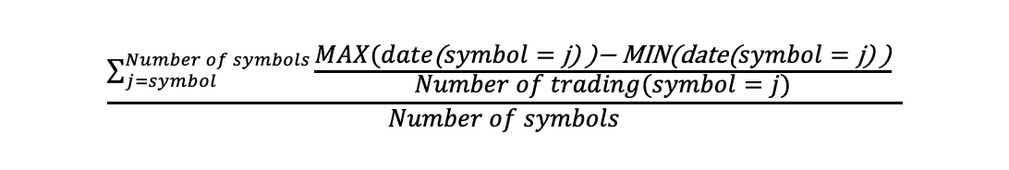
Appendix for formula of trading frequency

Slide 23
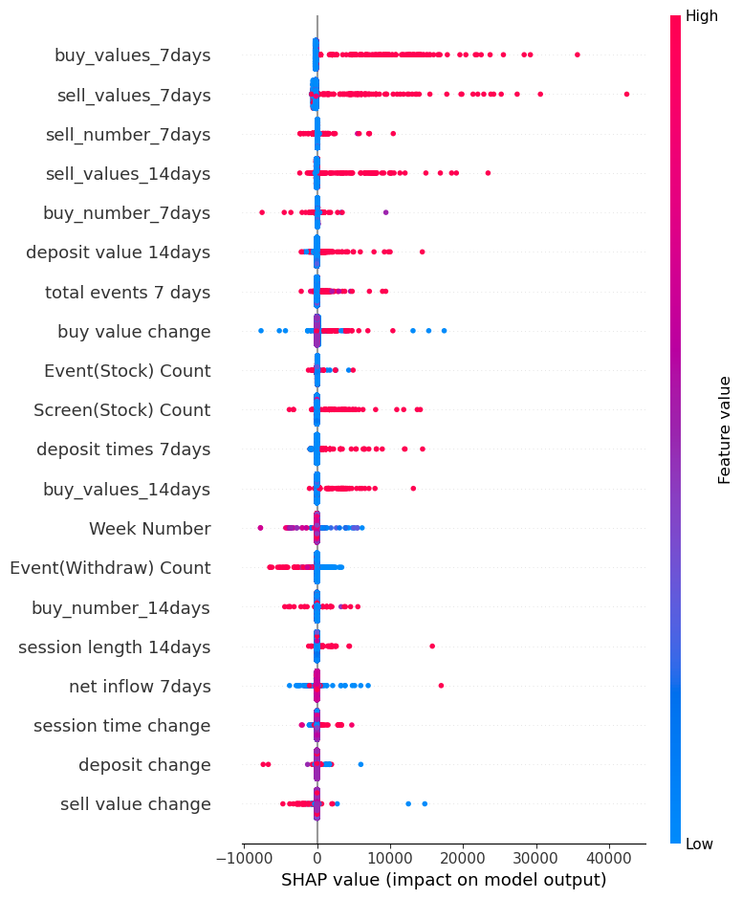
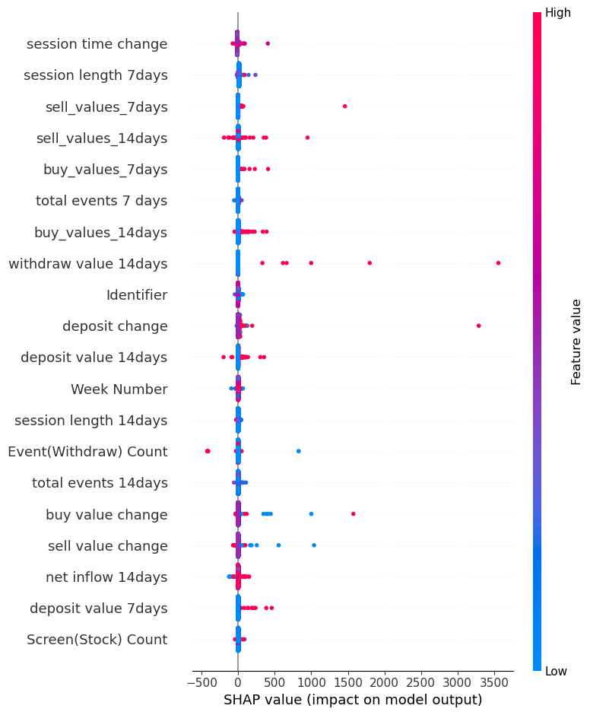
Appendix for SHAP Value Analysis of four groups
High value trading users
Dormant Users
Stable trading users
Less active trading users

Slide 24
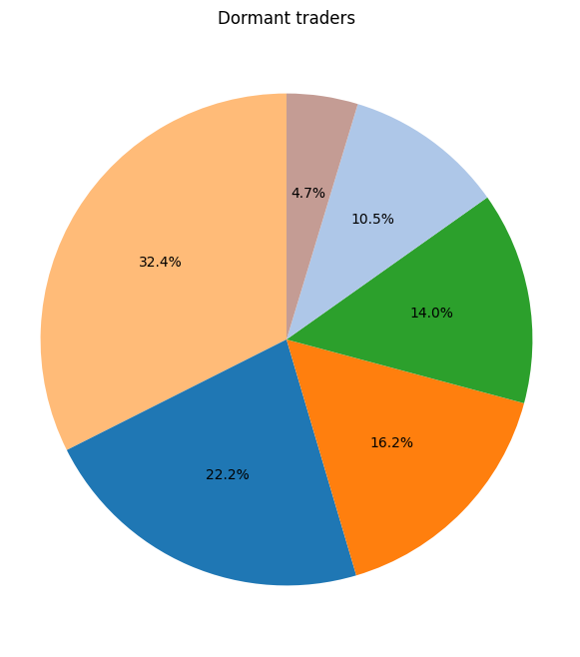
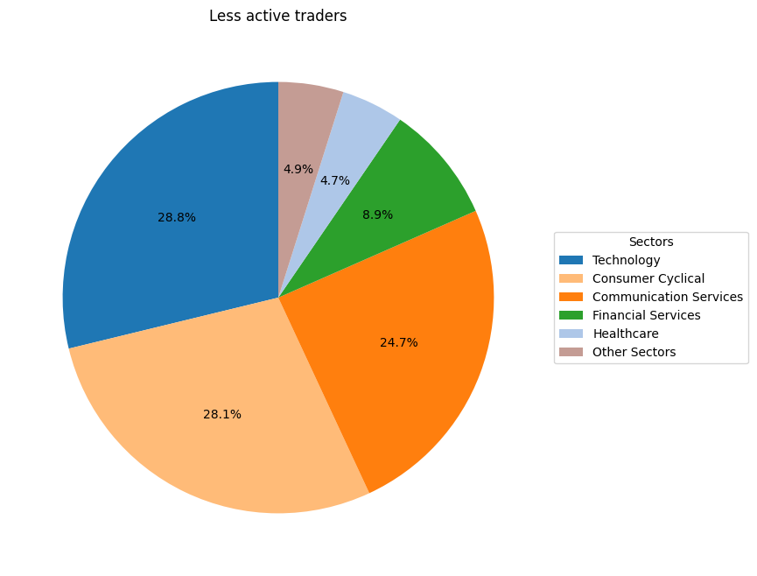
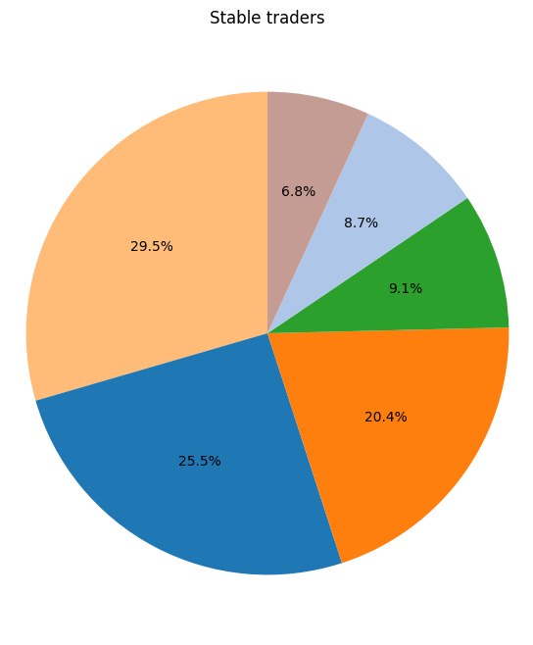
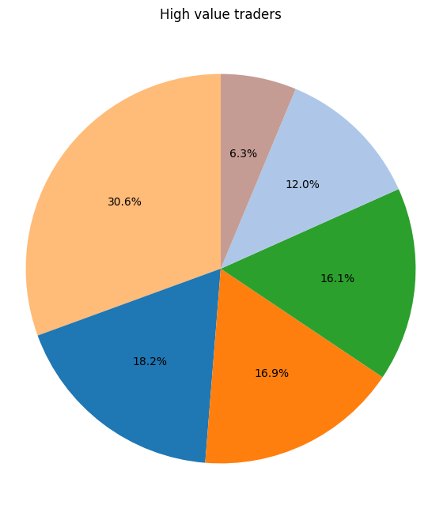
Appendix for the preference sectors

Slide 25

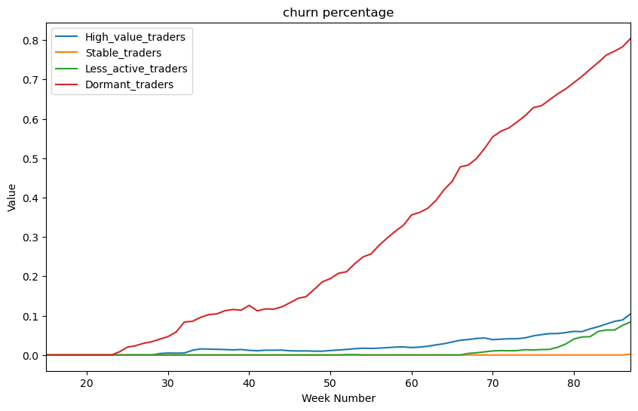
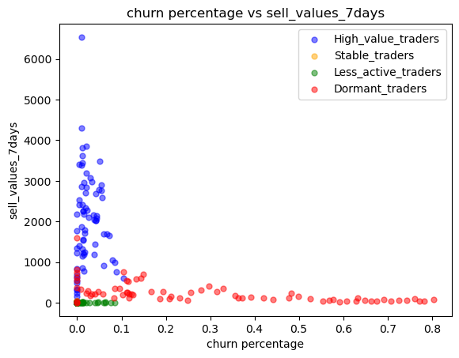
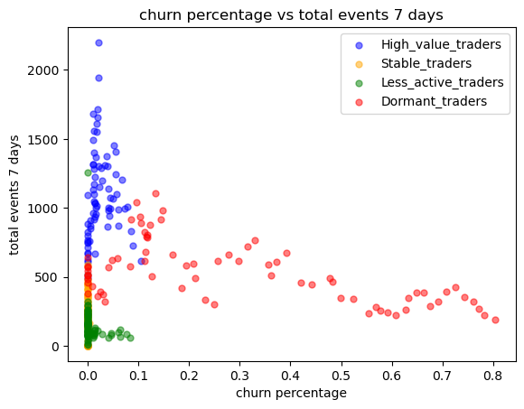
Model insights for the segments of the dormant users
## Do the exploration the period that they haven’t churn.
Dormant Users
Highest churn percentage
Less activity after they churn

Slide 26
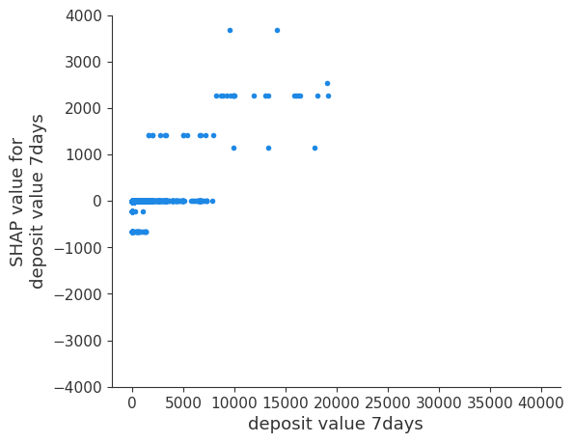
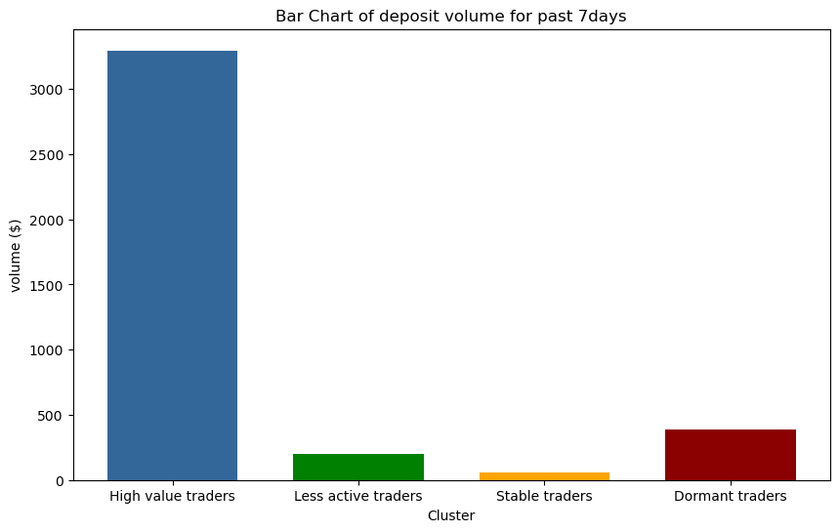
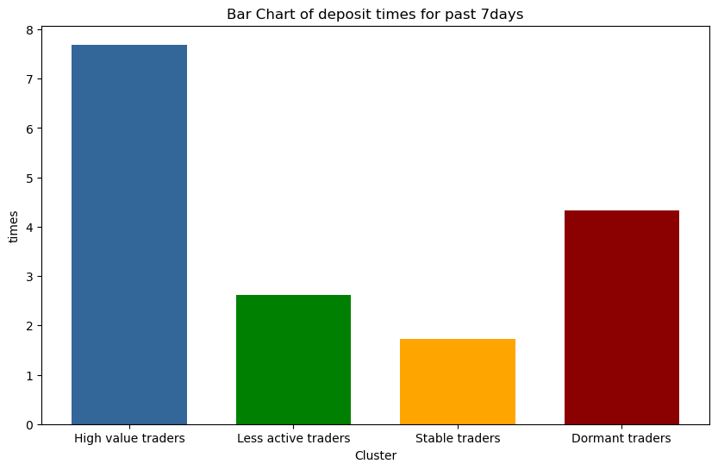
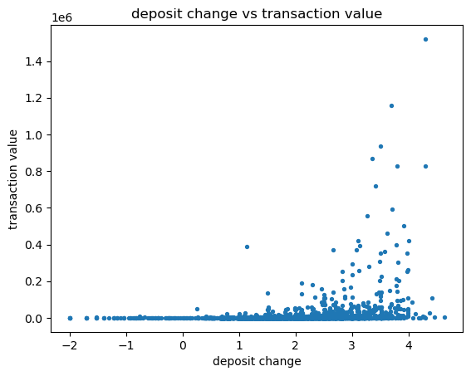
The causal drivers responsible for the value of transactions a user will make in the future ## If make sense, do the exploration about the characteristics.

